Slide 1
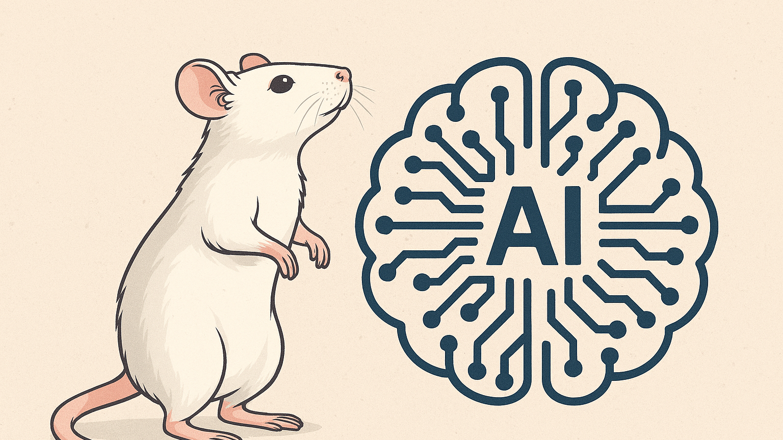
MABe Social Action Recognition in Mice
An attempt by:
Jeffrey Gregory
&
Mataeo Anderson

Slide 2
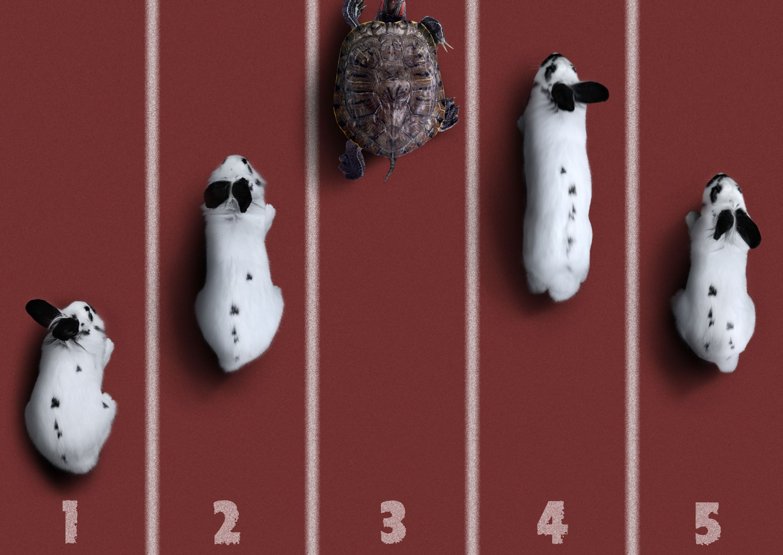
Challenge Overview
2D-tracking coordinates == behaviors?
Can ML be used to reliably annotate animal behaviors from tracking data?
Notes:
The end-goal is to use machine learning to extract meaningful information about the interactions between animals to improve our understanding of the animal kingdom. The question we attempt to answer, is, is there a meaningful relationship between the 2D tracking coordinate data and the labelled behaviours. Our hypothesis is yes, and the challenge is extracting that relationship in a machine learning algorithm.

Slide 3
Problem, Data, and Teamwork
Dataset provided through Kaggle competition page
Problem is multifaceted
Large dataset
Sparse labelling (class imbalance)
Data non-uniformity
Multi-class predictions
Data has low predictive power
Teamwork makes the dream work
Progress reports, updates, and contracts
Kaggle team and GitHub
Notes:
Trying to keep the slides from being too busy. Opens us up to the time-frame trap. But keeps the wordy verbiage off the slide.
Large dataset is a problem because the data set cannot be loaded into memory. Forces training in batches, mini-batches, or stochastic descent.
Class imbalance problem means models will automatically greedily try to train to predict no actions ever for high accuracy – fix...? Train using the custom F1 score to encourage predicting labels
Data non-uniformity = models expect the same data in the same format. More than just a missing data problem. Different labs tracked different sets of mouse body parts. Generally accepted fix is to train a model per body part set.
Multi-class predictions are problematic because many labels in the dataset are missing for any given body-parts set
Low-predictive power? What?! The tracking data is provided in Cartesian coordinates. These widely vary between poses of different mice and for mice of different sizes. This means that as is the dataset has very low predictive power. A big key to success in this challenge is extracting meaningful features from the given data. (I.E. distances between body parts per mouse and between mouse pairs.)
Teamwork = more brains better less brains
Weekly updates on individual progress, splitting tasks to maximize competition progress, team on kaggle to track submissions, GitHub for sharing code and version control.

Slide 4
EDA and Data Visualizations
Determine body-part missingness
Count action labels and calculate action duration statistics
Mouse skeleton viewer
Provides a human-interpretable view of the mouse data
Notes:
Not only are there multiple sets of body-parts tracked for the different labs, but within each file some body-parts are missing coordinate data for variables portions of the video.
Getting label counts and action duration statistics helps visualize the two-way class imbalance of the data set. Way more un-labelled frames than labelled frames, AND, some actions occur significantly more frequently than others, and some actions appear in dramatically more frames (actions last longer)
Jeffrey also built a skeleton viewer that converts the tracking data into a tool that animates the mouse skeletons with lines connecting the body parts and gives a human friendly representation of what the raw data to feed the models looks like.

Slide 5
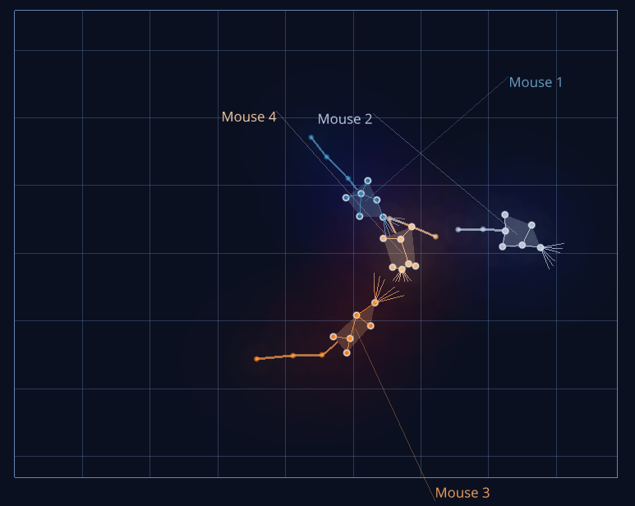
Notes:
Old version of the Mouser app as an example...

Slide 6
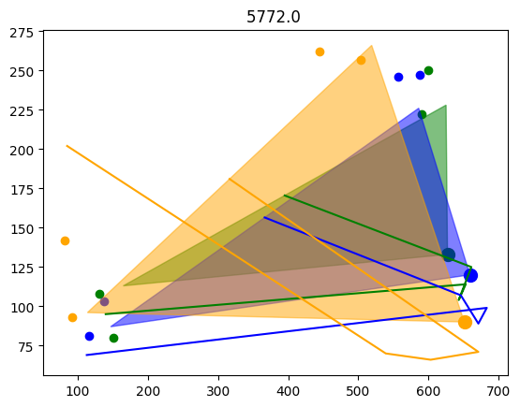
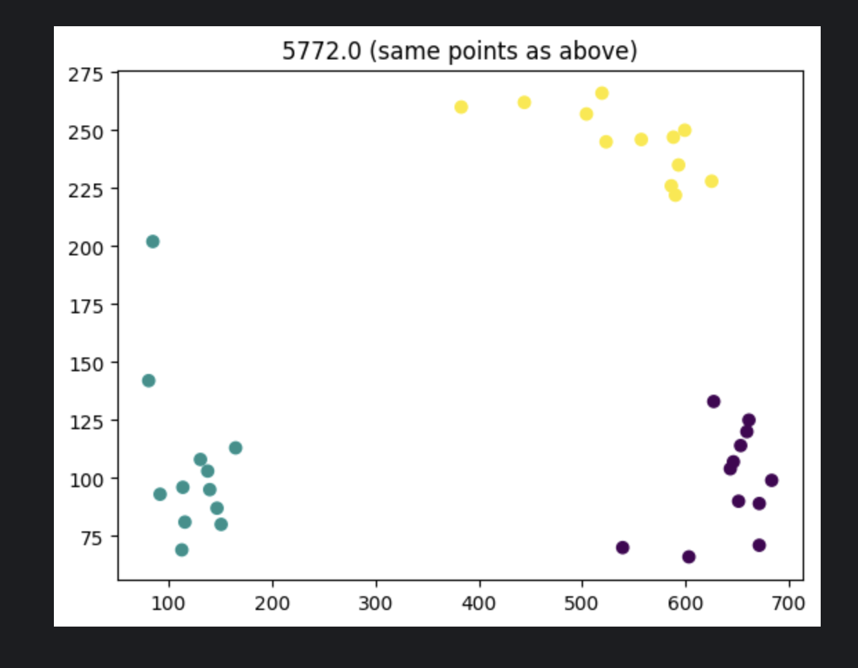
Corrupted Data... ?
Notes:
MABe22 Dataset largely made up of "huddles" that represent a very large (up to 80% depending on how you count) portion of the dataset
Ourselves and others were not able to figure out a way to reasonably use this data... previous competitions attempted heuristics.

Slide 7
Model Training and Evaluation
Where to even begin?!
Classic route of learn from the best then adapt
Get creative and try something different
Evaluation
Competition has a custom F1 score evaluation
Competition has its own hold-out test data
Train/dev/test splits locally then true test evaluation after submission
Notes:
Across human history apprenticeship has been a classic way to begin learning. Watch master's of a craft at work, and learn to imitate their process. Then begin branching out and adapting their process with your own flair and try to improve it.
We decided to really break the mold and develop a novel approach based on current SOTA skeleton-mapping models. We worked on developing a Graph Convolutional Network with channel-wise topology refinement (fancy word for it learns which data has best predictive power and gives it more weight while training)
Models were evaluated using the published custom F1 score. It more heavily penalizes labelling a frame as no action when the true label was an action, and applies a much lower penalty to labelling an action on a frame where no action occurs. This heavily punishes models predicting all no action from class imbalance, and encourages models to predict more actions. Models were able to truly be tested for generalization by the hold-out dataset the competition keeps for submissions to make inferences on.

Slide 8
Summary and Findings
Adapted Models
Ambrosm's Notebook, F1 score of 0.342
Gradient Boosting decision tree techniques
Extensive feature engineering
Our adaptations did not marginally increase performance, our highest F1 score was 0.448
Custom Model
GCN's are deep-learning models
Expensive compute to train
Work best with rich data with rich labelling
Model was difficult to train due to hardware restrictions
Model was unable to perform well due to being underfit for the data
Notes:
The Ambrohsm notebook was foundational to a lot of the public notebooks. Really great breakdown of the challenges of the challenge.
First great performance notebook we used, used, XGBoost, a gradient boosting technique that uses decision trees. It also used an extensive amount of feature engineering.
We attempted some further feature engineering on several notebooks, but were unable to increase the score past the baseline.
Our custom model was a 'moonshot' but an excellent learning experience. A good lesson in learning that choosing the best algorithm for the problem goes beyond simply selecting a strong algorithm that performs well on similar problems, it also depends on the dataset you have. GCNs require rich labelling with few no-action labels. They are also difficult to train due to computation time and cost due to being deep-learning algorithms. We learned creating custom model pipelines is very difficult, and the expertise of choosing the best model for a problem is harder than it seems at face value.

Slide 9
Potential solution, CTR-GCN?
Notes:
Deep-learning model that is particularly good at classification problems within sparse datasets of similar form, such as series of characters
However, likely is not possible to implement using Kaggle's 9-hour compute run-time limit

Slide 10

Questions?

Slide 11

References
https://www.kaggle.com/competitions/MABe-mouse-behavior-detection/discussion/608413
https://github.com/Uason-Chen/CTR-GCN
https://www.kaggle.com/code/ambrosm/mabe-nearest-neighbors-the-original/notebook#Challenge-4:-A-dataset-that-doesn't-fit-into-memory
https://www.kaggle.com/competitions/MABe-mouse-behavior-detection/overview
https://www.kaggle.com/competitions/MABe-mouse-behavior-detection/discussion/608413

